Slide 1
Lecture 21: Sharding (Part 3)
Data Availability
communication scaling
coded Merkle tree

Slide 2


Data Availability Attacks in Blockchain Systems
and How to Solve It.
I have all the data you want
Really …

Slide 3
Merkle Tree
A hash tree, also known as a Merkle tree, is a tree in which each leaf node is labeled with the cryptographic hash of a data block, and each non-leaf node is labeled with the cryptographic hash of its child nodes' labels. The majority of hash tree implementations are binary (each node has two child nodes), but they can also have many more child nodes.

Slide 4
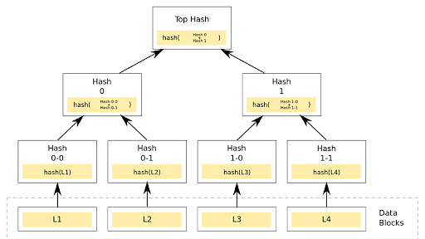

Slide 5
Merkle trees, also known as Binary hash trees, are a prevalent sort of data structure in computer science.
In bitcoin and other cryptocurrencies, they're used to encrypt blockchain data more efficiently and securely.
It's a mathematical data structure made up of hashes of various data blocks that summarize all the transactions in a block.
It also enables quick and secure content verification across big datasets and verifies the consistency and content of the data.

Slide 6
What Is a Merkle Root?
A Merkle root is a simple mathematical method for confirming the facts on a Merkle tree.
They're used in cryptocurrency to ensure that data blocks sent through a peer-to-peer network are whole, undamaged, and unaltered.
They play a very crucial role in the computation required to keep cryptocurrencies like bitcoin and ether running.

Slide 7
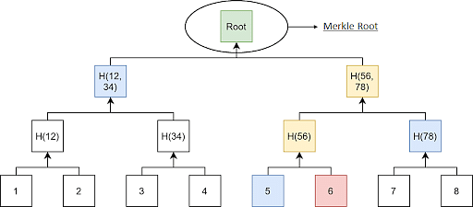

Slide 8
Cryptographic Hash Functions
A hash function maps any type of arbitrary data of any length to a fixed-size output. It is commonly used in cryptography since it is a cryptographic function.
They are efficient and are well-known for one property: they are irreversible. It's a one-way function that's only meant to work in one direction.
Some of the Hash families available are Message Direct (MD), Secure Hash Function (SHF), and RIPE Message Direct (RIPEMD).
Now, take an example, if you use the SHA256 hash algorithm and pass 101Blockchains as input, you will get the following output
fbffd63a60374a31aa9811cbc80b577e23925a5874e86a17f712bab874f33ac9

Slide 9
Working of Merkle Trees
A Merkle tree totals all transactions in a block and generates a digital fingerprint of the entire set of operations, allowing the user to verify whether it includes a transaction in the block.
Merkle trees are made by hashing pairs of nodes repeatedly until only one hash remains; this hash is known as the Merkle Root or the Root Hash.
They're built from the bottom, using Transaction IDs, which are hashes of individual transactions.
Each non-leaf node is a hash of its previous hash, and every leaf node is a hash of transactional data.

Slide 10
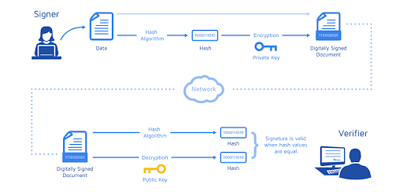

Slide 11
Now, look at a little example of a Merkle Tree in Blockchain to help you understand the concept.
Consider the following scenario: A, B, C, and D are four transactions, all executed on the same block. Each transaction is then hashed, leaving you with:
Hash A
Hash B
Hash C
Hash D
The hashes are paired together, resulting in:
Hash AB
and
Hash CD
And therefore, your Merkle Root is formed by combining these two hashes: Hash ABCD.
In reality, a Merkle Tree is much more complicated (especially when each transaction ID is 64 characters long). Still, this example helps you have a good overview of how the algorithms work and why they are so effective.

Slide 12
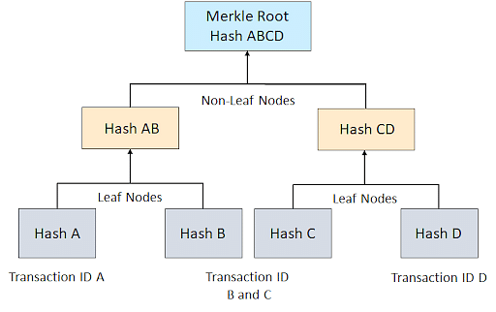

Slide 13
Benefits of Merkle Tree in Blockchain
Merkle trees provide four significant advantages -
Validate the data's integrity: It can be used to validate the data's integrity effectively.
Takes little disk space: Compared to other data structures, the Merkle tree takes up very little disk space.
Tiny information across networks: Merkle trees can be broken down into small pieces of data for verification.
Efficient Verification: The data format is efficient, and verifying the data's integrity takes only a few moments.

Slide 14
Why Is It Essential to Blockchain?
Think of a blockchain without Merkle Trees to get a sense of how vital they are for blockchain technology. Let’s have one of Bitcoin because its use of Merkle Trees is essential for the cryptocurrency and easier to grasp.
If Bitcoin didn't include Merkle Trees, per se, every node on the network would have to retain a complete copy of every single Bitcoin transaction ever made. One can imagine how much information that would be.
Any authentication request on Bitcoin would require an enormous amount of data to be transferred over the network: therefore, you'll need to validate the data on your own.
To confirm that there were no modifications, a computer used for validation would need a lot of computing power to compare ledgers.

Slide 15
Merkle Trees are a solution to this issue. They hash records in accounting, thereby separating the proof of data from the data itself.
Proving that giving tiny amounts of information across the network is all that is required for a transaction to be valid.
Furthermore, it enables you to demonstrate that both ledger variations are identical in terms of nominal computer power and network bandwidth.

Slide 16
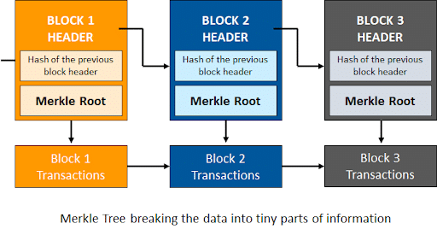

Slide 17


Merkle Tree Recap
I have all the data.
root
I know
H1234
Please give me
m2
H1234
H12
H34
Here it is:
m2
H1
H2
H3
H4
Prove to me your is genuine.
m2
leaf
m1
m2
m3
m4
H1234
A Merkle proof is a succinct proof of that
a message is one of the leaves of a Merkle tree.
H12
H34
H1
H2
Tamper-free
As long as you have the root, no one can deceive you to accept fake massages.
Merkle proof (2 hashes)
m2
☺

Slide 18

But There Are Other Problems …
I have full disclosed all the data to the public.
The root is 1234
H1234
Prove to me that you have fully disclosed.
I can send you a full copy if you want.
(So that you can disclose it to the public as well.)
How can you check the availability of all the messages without fully downloading them?
Don’t! My data plan is running low.
Does this problem matter?
You must be kidding me …

Slide 19
Motivation: blockchain light node
The data availability problem: assumptions and definition
How could erasure coding help?
The optimal solution
Performance

Slide 20
Play motivating video

Slide 21
Motivation: blockchain light node
The data availability problem: assumptions and definition
How could erasure coding help?
The optimal solution
Performance

Slide 22

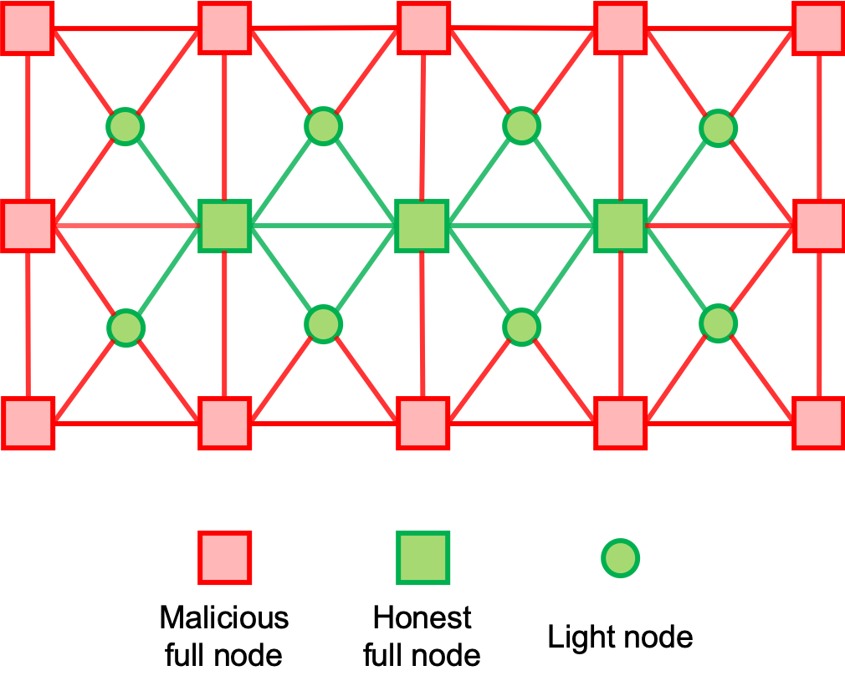


Assumptions
The data availability problem [1]
When
I published both
Body
&
H
miner
I received everything.
. is good, safe to accept
neighbor
Body
H
I only have How to check whether is
full available in the system or not?
H
Then
Body
No orphan: Every node is connected to at least 1 honest full node
Every honest node gossips/re-broadcast
Dishonest majority
Light node
Sampling is the only rescue.
How to make it efficient?
[1] Al-Bassam, M., Sonnino, A., Buterin, V., Fraud and data availability proofs: Maximising light client security and scaling blockchains with dishonest majorities, 2018

Slide 23
Motivation: blockchain light node
The data availability problem: definition and assumptions
How could erasure coding help?
The optimal solution
Performance

Slide 24
Erasure Coding
m1+2m2+3m3+4m4
m1+8m2+27m3+64m4
m1
m2
m3
m4
p1
p2
p3
p4
m1+m2+m3+m4
m1+4m2+9m3+16m4
(Finite field linear algebra)

Slide 25
Introducing Erasure Coding
m1+2m2+3m3+4m4
m1+8m2+27m3+64m4
m1
m2
m3
m4
p1
p2
p3
p4
m1+m2+m3+m4
m1+4m2+9m3+16m4
Any 50% symbols allow full recovery
(1-dimensional Reed-Solomon code, 1D-RS)

Slide 26
Merkle Tree of Erasure Coded Block (Not coded Merkle tree!)
root
h1234
h5678
h12
h34
h56
78
h1
h2
h3
h4
h5
h6
h7
h8
m1
m2
m3
m4
p1
p2
p3
p4
The miner only needs to publish the (uncoded) block and the root.
Any full node can reproduce the tree and verify.

Slide 27



Malicious Miner Can’t Hide
root
root
h1234
h1234
h5678
h5678
h12
h78
h12
h34
h34
h56
h56
h78
h1
h2
h4
h1
h2
h3
h4
h6
h8
h3
h5
h7
h8
h7
m1
m2
m4
p4
m2
p1
p2
p3
m3
m4
p3
Show me m2
Show me m4
Show me p3
Show me …
The miner cannot disclose anymore!
It has to hide all the remaining 5.
This is easily detectable!

Slide 28
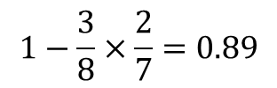

Coding v.s. no coding
No coding
The malicious miner hides 1 data symbol
Probability of catching hiding after 2 random samplings?
$$1−\frac{3}{4}×\frac{2}{3}=0.5$$
Catch prob.
m1
m2
m3
m4
100%
Coding O(1) samples
Coding
The malicious miner must hide 5 coded symbols
No coding Linear samples
m1
m2
m3
m4
p1
p2
p3
p4
# of data symbols
Probability of catching hiding after 2 random samplings?
Number of random samplings
$$1−\frac{3}{8}×\frac{2}{7}=0.89$$

Slide 29


But Malicious Miner Can Mess up with the Coding!
Introducing incorrect-coding proof
root
h1234
h5678
h12
h34
h56
h78
h1
h2
h1
h3
h4
h5
h6
h7
h8
m1
m2
m3
m4
P1=%^^&*)$
P2=&^%$%$
P3=#$%^^&
P4=*&^%$#
Incorrect-coding attack
Miner can encode incorrectly and publish almost everything.
Light node can hardly catch hiding.
Alert!
m2
m3
P1
P2
root
OK. Let me verify by reproducing.
Incorrect-coding
proof
(Proof size = block size !!!)

Slide 30
Summary of Costs
root
h1234
h5678
h12
h34
h56
h78
h1
h2
h1
h3
h4
h5
h6
h7
h8
m1
m2
m3
m4
p1=%^^&*)$
p2=&^%$%$
p3=#$%^^&
p4=*&^%$#
 | # of roots | # of samples & Merkle proofs | Incorrect-coding proof size | En/decoding complexity
1D-RS | 1 | O(1) | O(K) | O(K²)
K: block size in terms of number of symbols it is partitioned into.

Slide 31

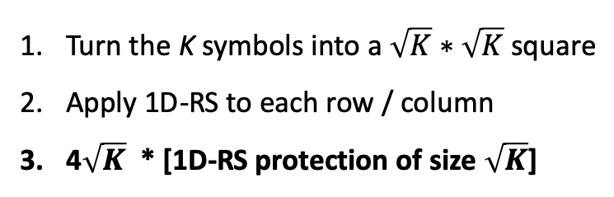
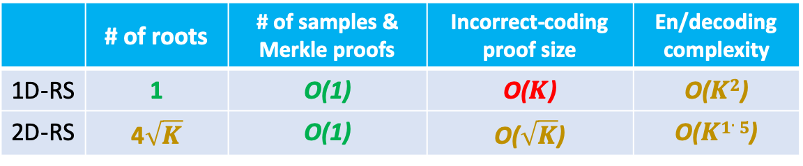
2D-RS: Divide and Conquer [1]
CR1
CR2
CR3
CR4
m1
m2
c1
c2
RR1
Turn the K symbols into a $\sqrt{K}∗\sqrt{K}$ square
Apply 1D-RS to each row / column
4$\sqrt{K}$ * [1D-RS protection of size $\sqrt{K}$]
m3
m4
c3
c4
RR2
c5
c6
c7
c8
RR3
 | # of roots | # of samples & Merkle proofs | Incorrect-coding proof size | En/decoding complexity
1D-RS | 1 | O(1) | O($K$) | O($K2$)
2D-RS | 4$\sqrt{K}$ | O(1) | O($\sqrt{K}$) | O($K1.5$)
c9
c10
c11
c12
RR4
[1] Al-Bassam, M., Sonnino, A., Buterin, V., Fraud and data availability proofs: Maximising light client security and scaling blockchains with dishonest majorities, 2018

Slide 32
Motivation: blockchain light node
The data availability problem: definition and assumptions
How could erasure coding help?
The optimal solution
Performance

Slide 33
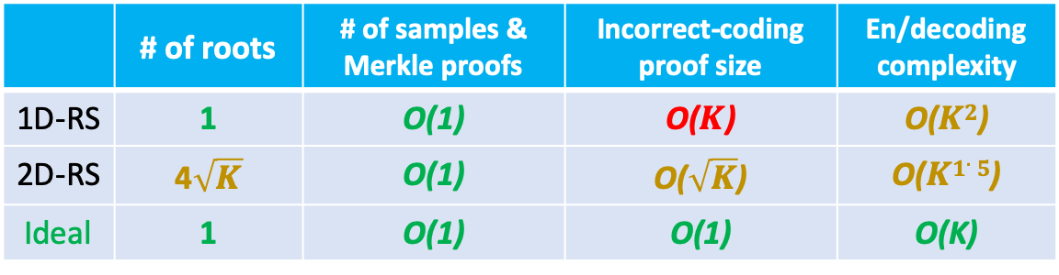
The Derivation
 | # of roots | # of samples & Merkle proofs | Incorrect-coding proof size | En/decoding complexity
1D-RS | 1 | O(1) | O($K$) | O($K2$)
2D-RS | 4$\sqrt{K}$ | O(1) | O($\sqrt{K}$) | O($K1.5$)
Ideal | 1 | O(1) | O(1) | O(K)
One code
No dividing
Good code
Any x% decode
Low density code
p1=m1+m3
p2=m2+m4
…
Iterative decoding
Decode & verify one equation a time
A good low-density parity check (LDPC) class
Equation size = 6, any 87.6% allows full recovery using iterative decoding.

Slide 34
Attack: Incorrect coding + hide hashes
root
h1234
h5678
h12
h34
h56
h78
h1
h2
h1
h3
h4
h5
h6
h7
h8
m1
m2
m3
m4
p1=%^^&*)$
p2=&^%$%$
p3=#$%^^&
p4=*&^%$#
p1=m1+m3
This idea only works if:
all the layer-1 hashes are available.
m1
I have m3 & p1, , let me recover m1. as m1=p1-m3
m3
p1
m1
Is my correct? Wait, I don’t have h1 !
h1
Err. I should also check layer-1 availability …

Slide 35
Introducing: Coded Merkle Tree
root
Hashing
Erasure encoding
Hashing
A block
Erasure encoding
Hashing
Erasure encoding
Partitioning
Hashing
Erasure encoding
Notes:
Coded Merkle tree is constructed as follows:
The block is evenly partitioned into k1 data symbols;
Then p1 parity symbols are generated using these data symbols through erasure code. I.e., each parity symbol is a linear combination of some of the data symbols;
The resulted n1=k1+p1 coded symbols are hashed;
These n1 hashes are batched into k2 data symbols for the next layer;
The k2 data symbols are erasure encoded into n2 coded symbols;
Repeat 3-5 until the new layer is small enough as a block header.

Slide 36
Light node sampling
root
Every layer is automatically sampled
Also offer free extra sampling
Notes:
Comments:
Due to erasure coding, each layer is recoverable as long as a portion (say 50%) of it is available;
Thus, to prevent revealing a coded layer, the malicious miner has to hide a substantial portion of this coded layer (say 51%+);
This allows a light node to catch hiding at any layer with a very high probability (51%+ per sampling request) by sampling base layer symbols and their Merkle proofs;
With an almost constant sampling cost (say 20 samples), a light node can be 99.99% sure.

Slide 37

Honest Full Node Layer-by-Layer Recovery
root
An honest full node can decode and audit layer by layer.
Incorrect coding detected!
Reject this block!
Notes:
Comments:
An honest full node can decode the layer one by one;
A decoded layer provides the hashes of the symbols of the next (lower) layer. When decoding the next (lower) layer, these hashes allow the full node to check the correctness of the decoded symbols. This will deter malicious miners from generating wrong coded symbols, so that even if it reveals a lot of symbols, nothing can be correctly decoded.

Slide 38
Motivation: blockchain light node
The data availability problem: definition and assumptions
How could erasure coding help?
Our solution
Performance

Slide 39
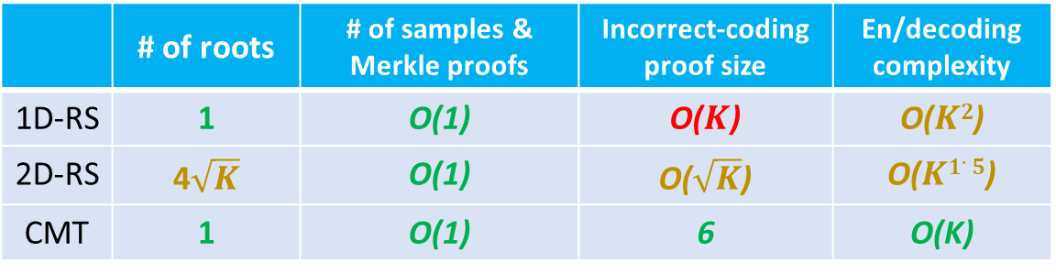
Performance
 | # of roots | # of samples & Merkle proofs | Incorrect-coding proof size | En/decoding complexity
1D-RS | 1 | O(1) | O($K$) | O($K2$)
2D-RS | 4$\sqrt{K}$ | O(1) | O($\sqrt{K}$) | O($K1.5$)
CMT | 1 | O(1) | 6 | O(K)
If K=65536, encode to 65536*4 coded symbols:
 | # of roots | # of samples & Merkle proofs for 99% confidence | Incorrect-coding proof size (# of symbols) | En/decoding complexity
1D-RS | 1 | 7 | 65536 | 13B ops
2D-RS | 1025 | 15 | 256 | 50M ops
CMT | 1 | 32 | 6 | 1.2M ops

Slide 40







Summary
Light node cost
CMT Enable data availability check at almost constant costs
1MB
1GB
1TB
Block size
Extremely simple to implement. Just add CMT root (32 Bytes) to block header or a smart contract.
Designed to scale blockchains, but can be used for any decentralized systems vulnerable to data hiding.

